Slide 1

What is Android?
Android is an open source and Linux-based operating system for mobile devices such as smartphones and tablet computers. Android was developed by the Open Handset Alliance, led by Google, and other companies.

Slide 2


Slide 3
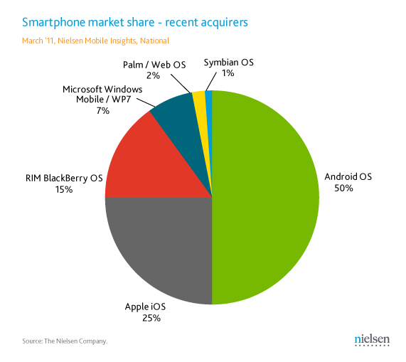
Market Demand of Android

Slide 4
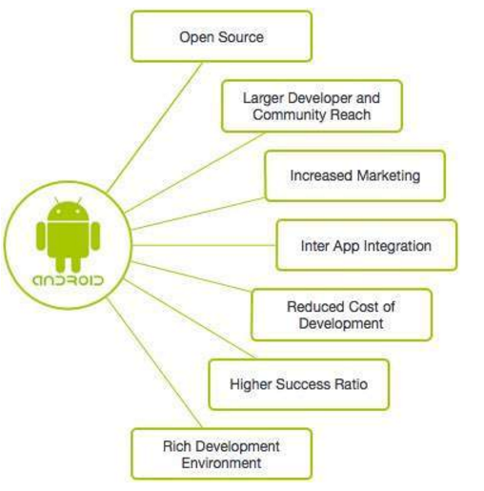
Why Android ?

Slide 5
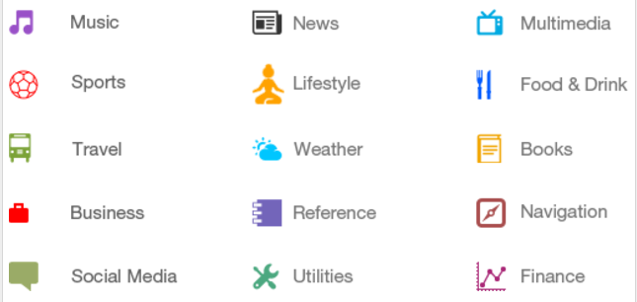
Categories of Android applications

Slide 6
API level
API Level is an integer value that uniquely identifies the framework API revision offered by a version of the Android platform.
Application program interface (API) is a set of routines, protocols, and tools for building software applications. An API specifies how software components should interact and APIs are used when programming graphical user interface (GUI) components.

Slide 7
API level
Platform Version | API Level | VERSION_CODE
Android 5.1 | 22 | LOLLIPOP_MR1
Android 5.0 | 21 | LOLLIPOP
Android 4.4W | 20 | KITKAT_WATCH | KitKat for Wearables Only
Android 4.4 | 19 | KITKAT
Android 4.3 | 18 | JELLY_BEAN_MR2

Slide 8
Android IDEs
An android Integrated Development Environment (IDE) is an all-in-one solution that allows an application (app) developer (a.k.a. programmer) to perform the software development cycle repeatedly and quickly.
There are so many sophisticated Technologies are available to develop android applications, the familiar technologies, which are predominantly using tools as follows
Android Studio
Eclipse IDE

Slide 9
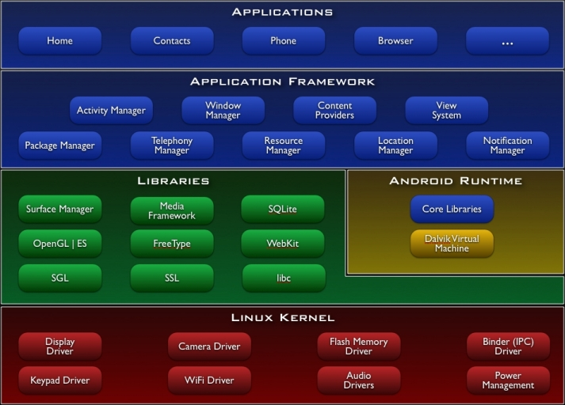
Android architecture

Slide 10

Android Libraries
❑ android.util
❑ android.os
❑ android.graphics
❑ android.text
❑ android.database
❑ android.content
❑ android.view
❑ android.widget
❑ com.google.android.maps
android.app
❑ android.telephony
❑ android.webkit

Slide 11
Application Framework
The Android framework includes the following key services
Activity Manager − Controls all aspects of the application lifecycle and activity stack.
Content Providers − Allows applications to publish and share data with other applications.
Resource Manager − Provides access to non-code embedded resources such as strings, color settings and user interface layouts.
Notifications Manager − Allows applications to display alerts and notifications to the user.
View System − An extensible set of views used to create application user interfaces.

Slide 12
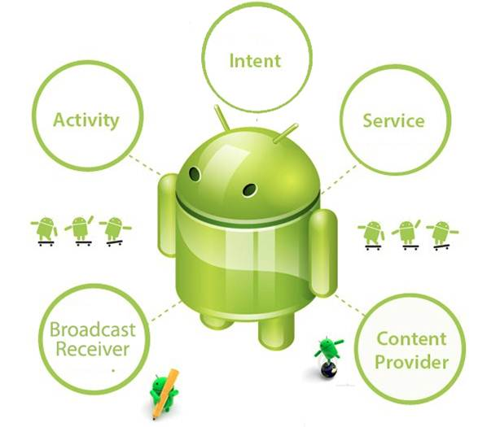
Four main components that can be used within an Android application:

Slide 13
Four main components that can be used within an Android application:
Components | Description
Activities | They dictate the UI and handle the user interaction to the smart phone screen
Services | They handle background processing associated with an application.
Broadcast Receivers | They handle communication between Android OS and applications.
Content Providers | They handle data and database management issues.

Slide 14
Activities
An activity represents a single screen with a user interface, in-short Activity performs actions on the screen.
For example, an email app might have one activity that shows a list of new emails, another activity to compose an email, and another activity for reading emails.
An activity is implemented as a subclass of Activity class as follows −

Slide 15
Services
A service is a component that runs in the background to perform long-running operations.
This could be to sync some data in the background or play music even after the user leaves the app.

Slide 16
Broadcast Receivers
Broadcast Receivers simply respond to broadcast messages from other applications or from the system.
It allows the app to respond to system-wide broadcast announcements.
So, for example, an app can schedule an alarm to post a notification to tell the user about an upcoming event... and by delivering that alarm to a BroadcastReceiver of the app, there is no need for the app to remain running until the alarm goes off.

Slide 17
Content Providers
A content provider component supplies data from one application to others on request. Such requests are handled by the methods of the ContentResolver class. The data may be stored in the file system, the database or somewhere else entirely.
For example, the Android system provides a content provider that manages the user's contact information.

